Slide 1

The way to efficient commercial real estate

Slide 2
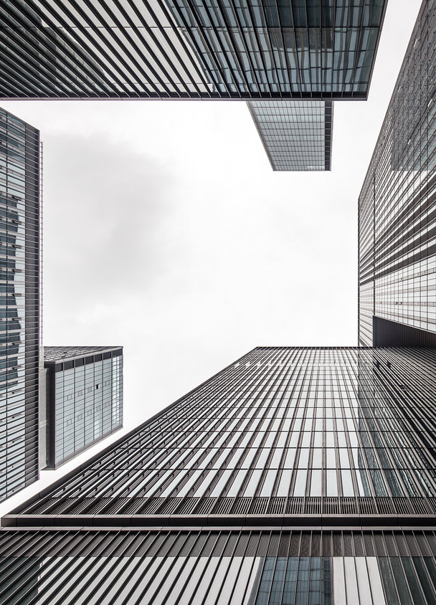
Challenge: Rapid Growth of Commercial Real Estate
Hangzhou
Annual Growth: 19%
Vacancy Rate: 17%
Grow in non-prime areas: 83%
(incl. Wanxiang Innovation City 万向创新聚能城)
Notes:
China
Annual Investment: 500 BIL ¥
High growth but still loads of empty space. People need a trustless system because there distrust …
People wane feel more secure in doing business
Most of the growt in non-prime areas
Bridge between owners and growing companies
We want to be the bridge between
commercial real estate owners and
growing companies, using the flexible,
Secure, and efficient blockchain technology

Slide 3






Solution: Rental Lease Contracts as Digital Assets
Split Asset
1st Leaser
1st Leaser
Owner
Split Asset
2nd Leaser

Slide 4
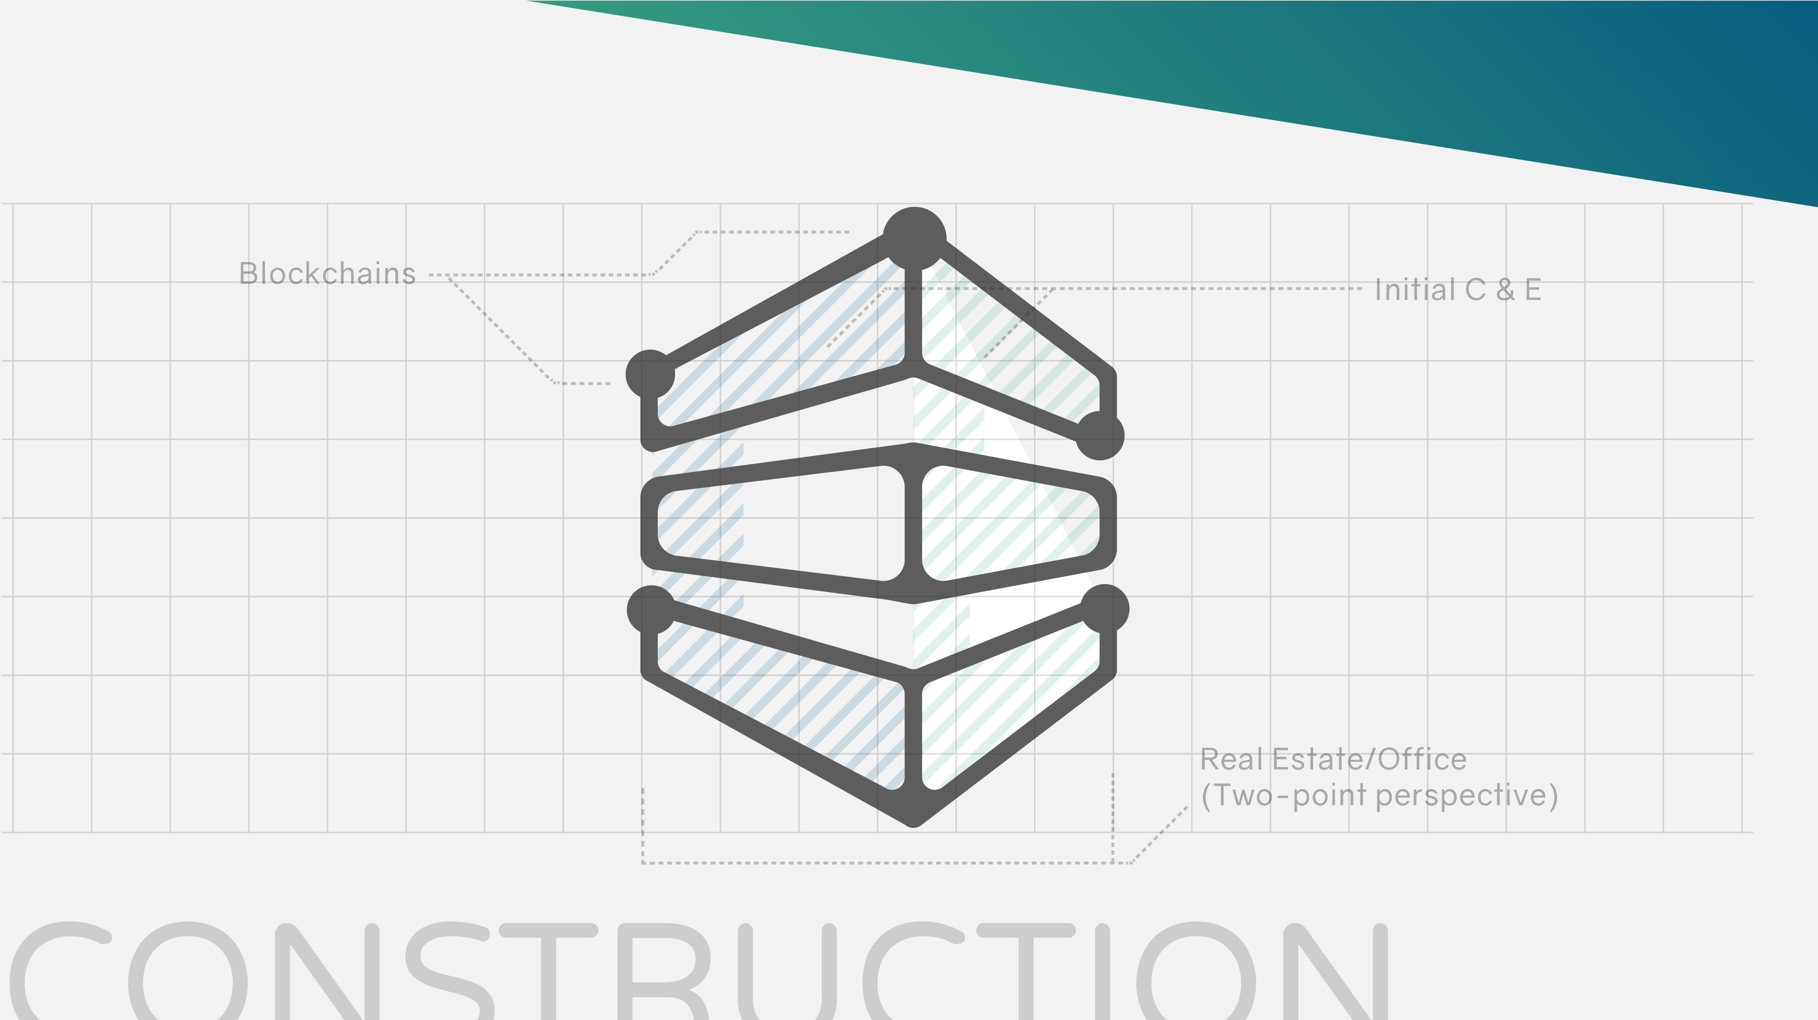
Live Demo: Digital Asset creation

Slide 5
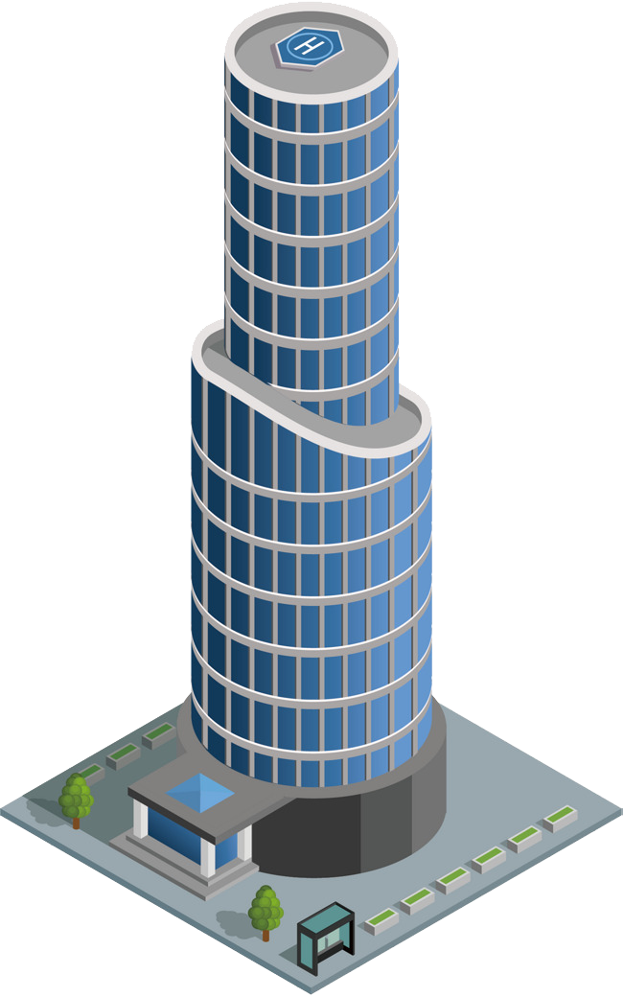





Architecture: Digital asset connected to real world assets
Data Name
Price per M2
Price
Status (V, O, S)
Lease start/end
Parent ID Deposit
Payment dates
Leaser rating
Etc …
ERC721 token Digital Asset
Government
Smart Cities
Frontend
Interaction
ERC20 token for incentive

Slide 6
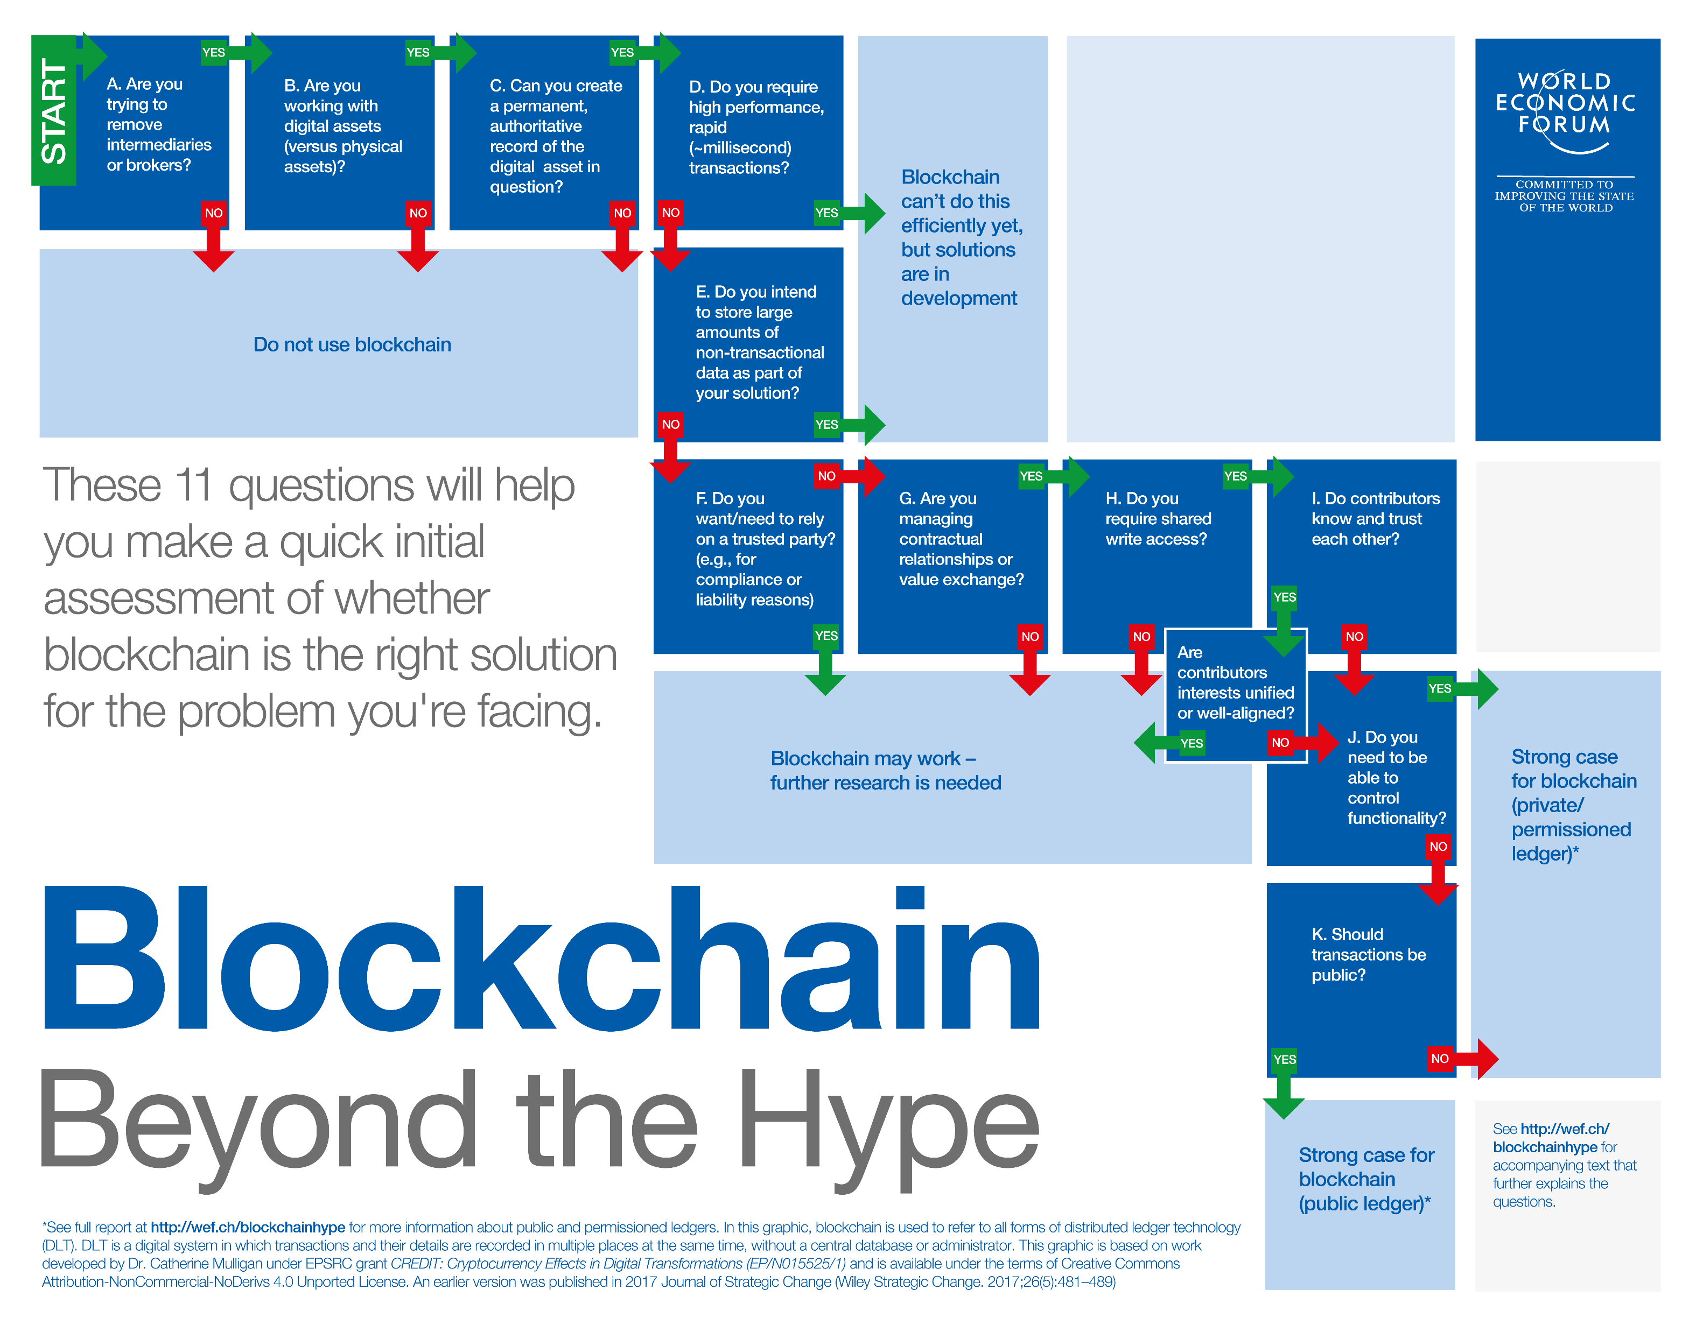
Do we need a Blockchain for that?
The Xiong’an New Area（雄安新区）
is experimenting with similar tech
Solving the illiquidity problem for commercial real estate
A more efficient secondary markets
Better control of common space
Budget management improvement

Slide 7


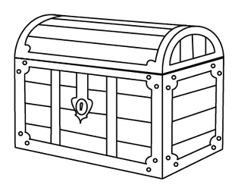

Potential Token Economic models
Work funded DAO model
Self funded funded DAO model
Freemium secondary market

Slide 8
The Chain Estate Rock Stars
Andrey Bogomolov – Real estate Hacker
Ted Wu – Alround superstar
ShiTao He – Research Boss Amadeo Brands – Coin slayer

Slide 9
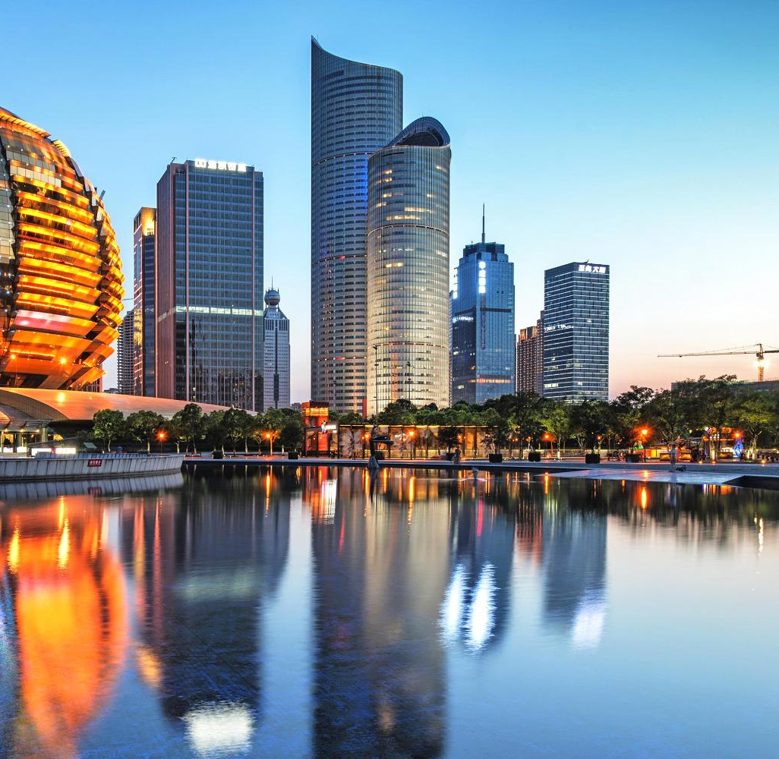
Thank you Any Questions?
We want to be the bridge between
commercial real estate owners and
growing companies, using the flexible,
Secure, and efficient blockchain technology

Slide 10


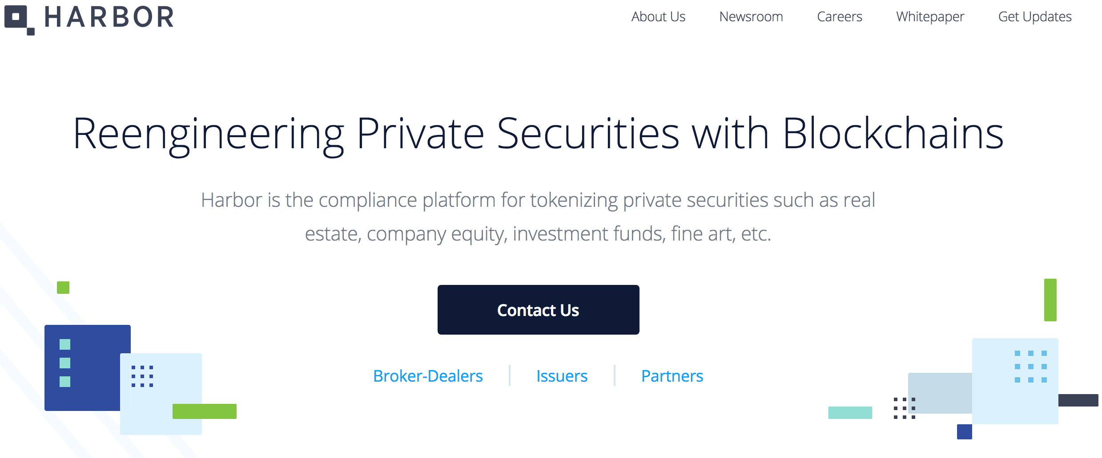

Competitors in Blockchain with Real Estate
Example:

